Slide 1
Deep Learning Dynamos
Gema Csanád

Slide 2
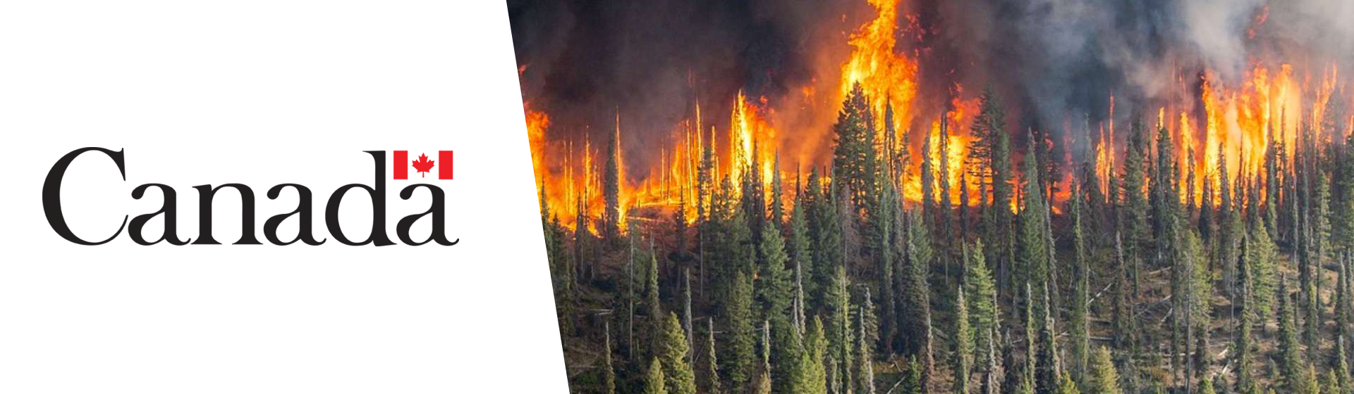
Topic: Wildfire Detection Using Satellite Images

Slide 3
Autonomous Satellite Wildfire Detection Using Hyperspectral Imagery and Neural Networks:
Landsat-8 data
3D CNN: Goes-16 data
Real-time analysis
Deployed in Australia
Source

Slide 4
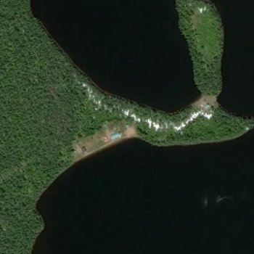
Data exploration
Kaggle
Wildfire : 22710 images
No wildfire : 20140 images
70/15/15

Slide 5
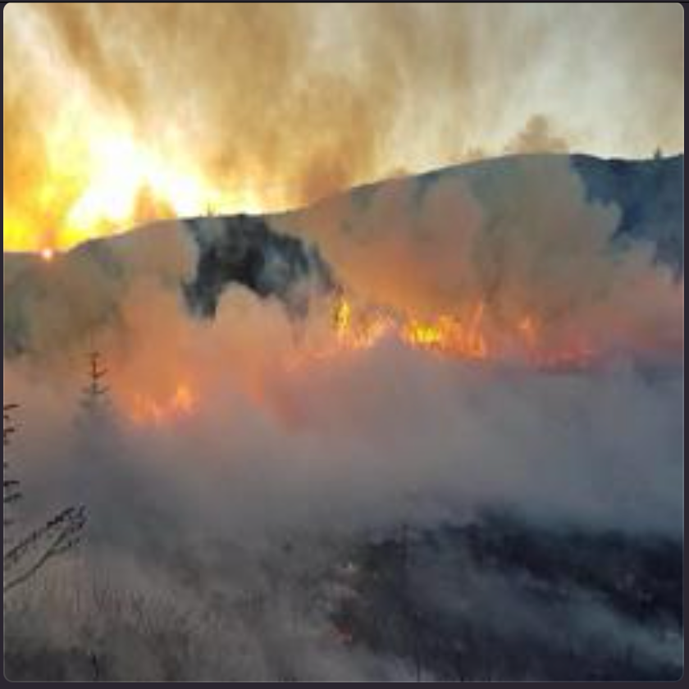
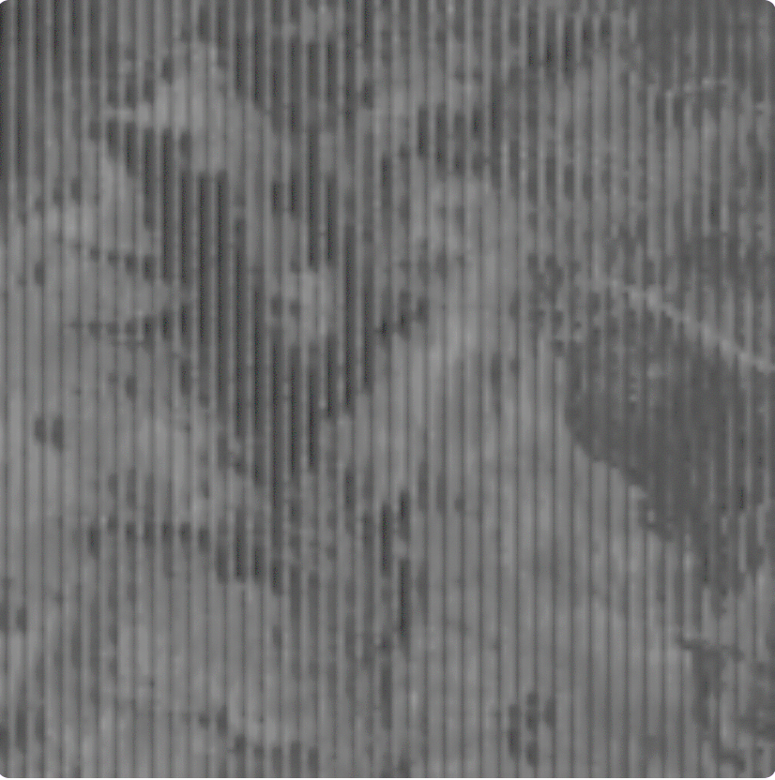
Other Datasets

Slide 6
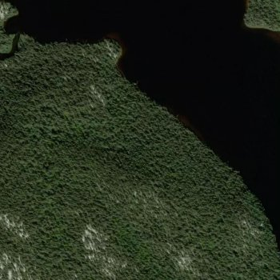
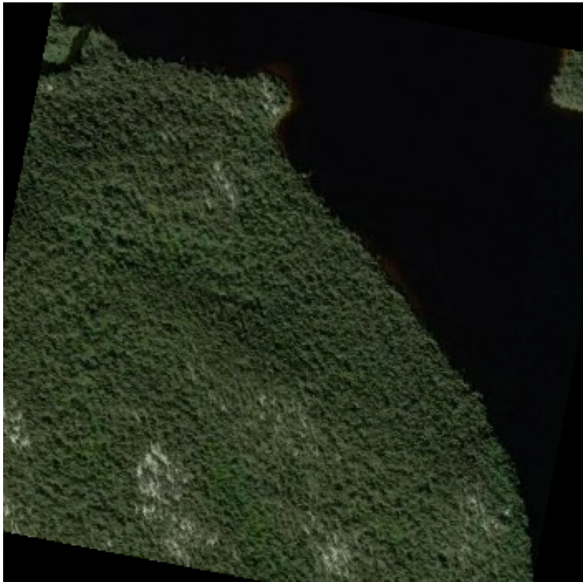
Data augmentation
Original
Rotation (±30°)

Slide 7
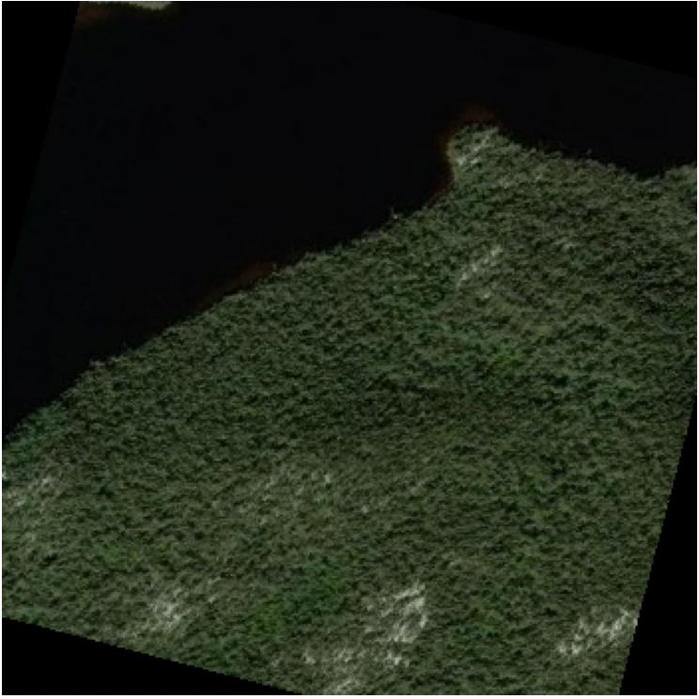
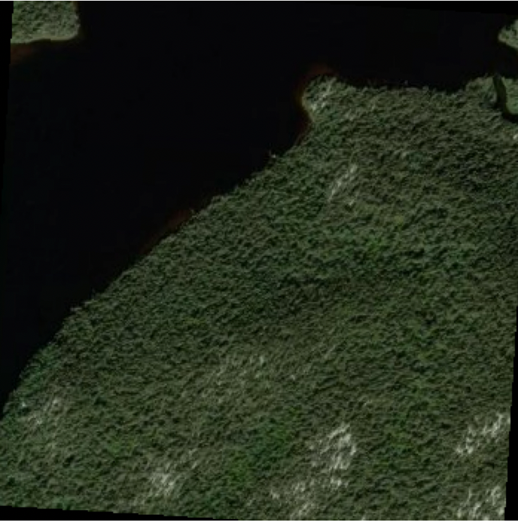
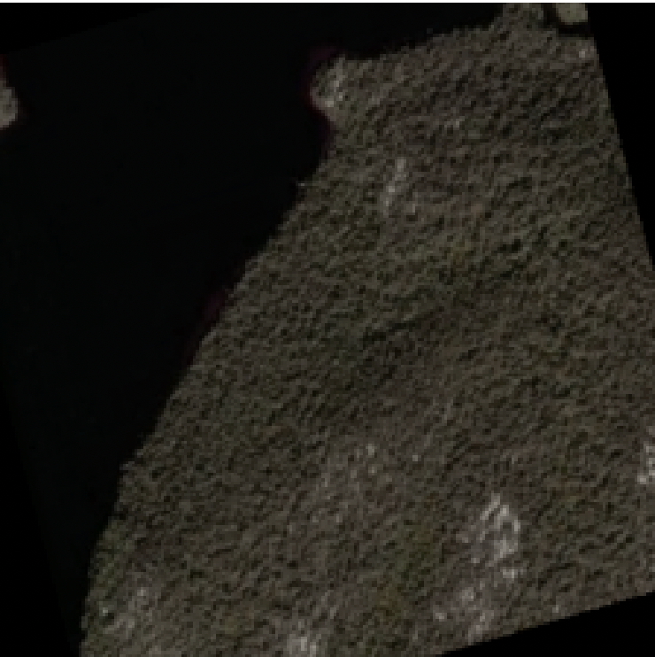
Data augmentation
Random Horizontal
Flipping
Random Resized
Crop
Colour Adjustments

Slide 8
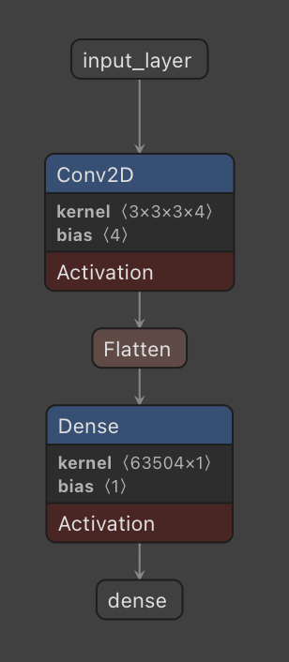
Baseline model: 2D CNN
Spatial Feature Extraction
Translation Invariance
Hierarchical Feature Learning
Performance
Discriminative Features for Smoke vs. Clouds

Slide 9
Training
Binary cross-entropy loss
Optimizer: Adam
Initial learning rate: 0.001
Batch size: 32
Early stopping

Slide 10
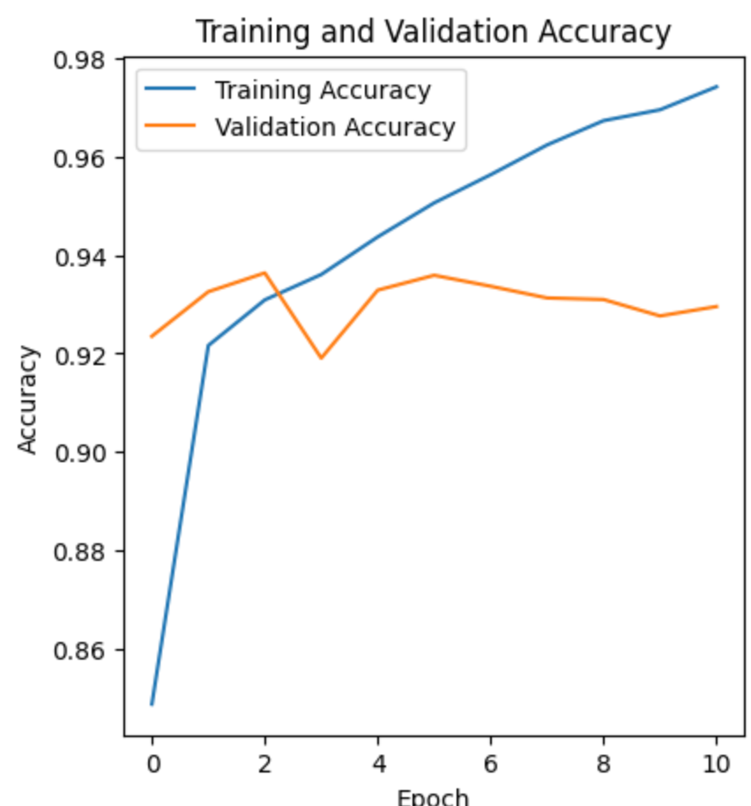
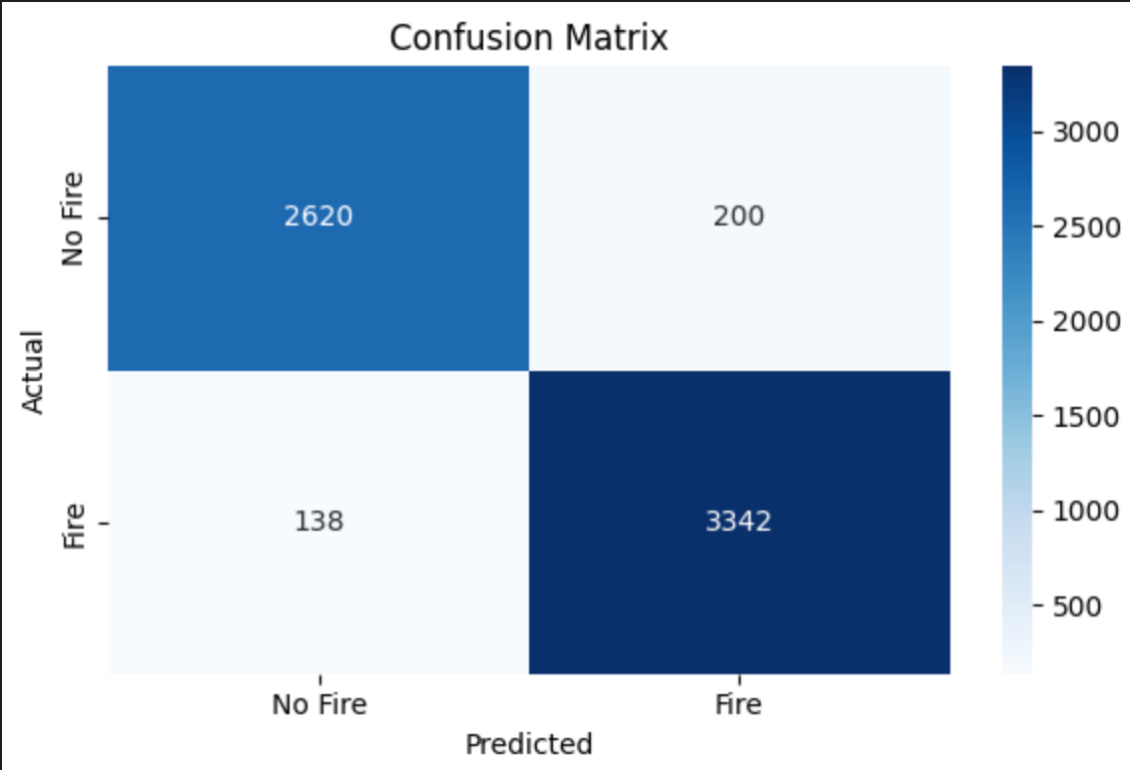
Medium Model
Parameters: 762773
Accuracy: 94%

Slide 11
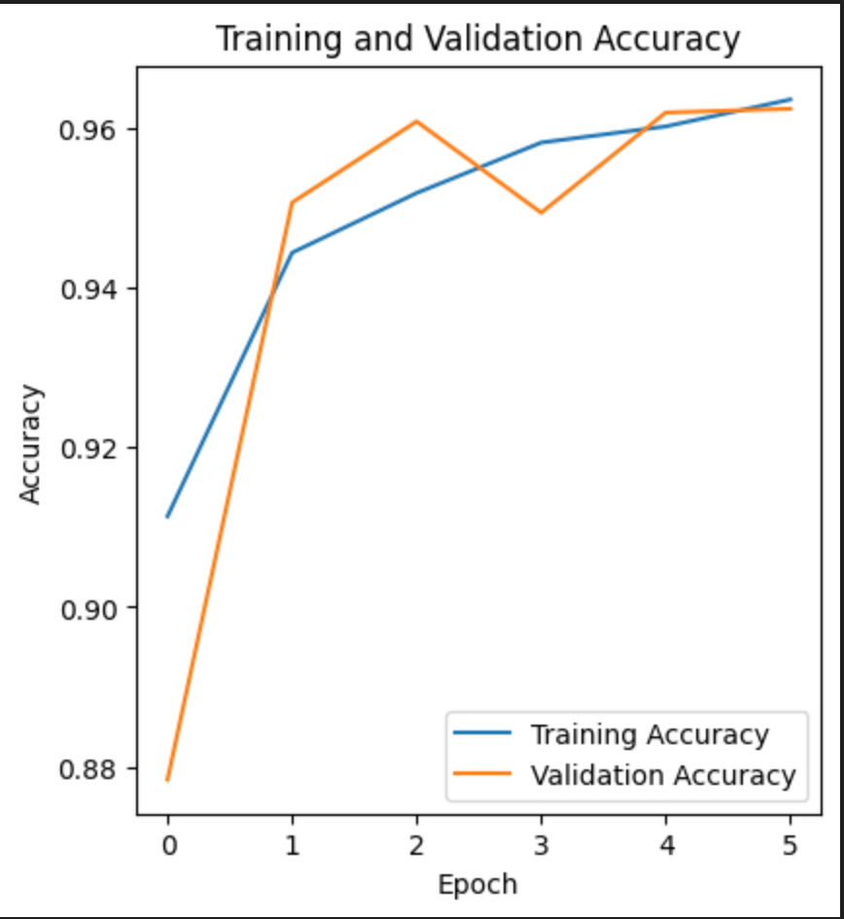
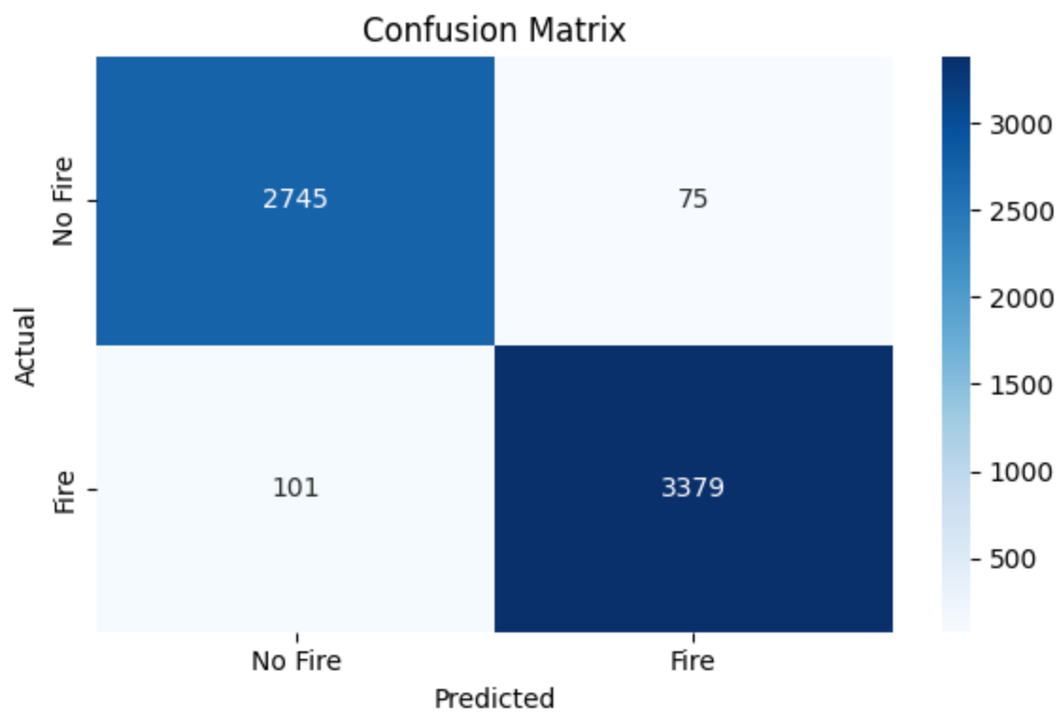
Large Model
Parameters: 3304769
Accuracy: 96%

Slide 12
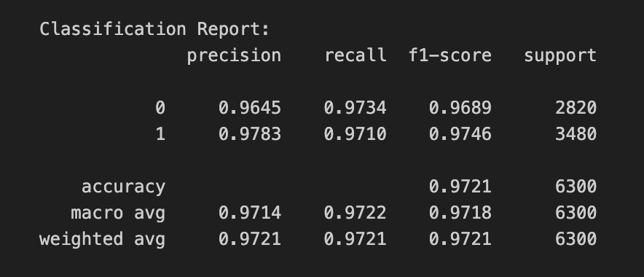
Validation set
Accuracy
Precision
Recall
F1

Slide 13
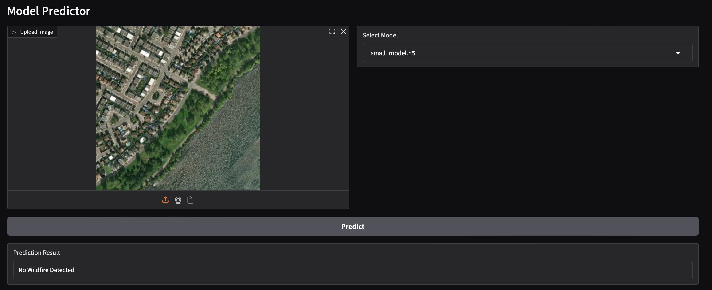
GUI
Gradio
Web based
Upload photo
Can choose from models
Detects wildfire

Slide 14
Conclusions
Accurate model can be build with CNN
Future improvements
Temporal data
3D CNN
Expand the dataset

